Slide 1

GENERAL INTEGRATED SCIENCE– UNIT 2 TASK 13 – Rocket Design Extended Response
MARKING KEY
Worth 20% of task mark
41 possible marks
WEIGHTING: 7.5 %

Slide 2
What are the main features of a rocket? [4 marks]
4 Marks:
Structural System (Nose Cone, frame, fin)
Payload system
Guidance system
Propulsion system (fuel, oxidiser, pumps, nozzle)

Slide 3
What are the different types of: Nose cone, Fins & Body Shape [3 marks]
Cone – parabolic, elliptical, ogive, conical, solid cylinder, vented cylinder) (1 mark for listing 3)
Fins – semi-circular, triangle, elliptical, trapezoidal, square, clipped delta (1 mark for listing 3)
Body Shape – cylinder, bullet, triangulae, etc (1 mark for listing 2)

Slide 4
Rockets have different shapes based on these features. Which shape rocket do you believe will fly the furthest? [3 marks]
Cone shaped nose cone with elliptical fin. (1 mark)
Cone nose cone – more aerodynamic (1 mark)
Elliptical fin – least amount of drag, most amount of lift. (1 mark)

Slide 5
Describe the term ‘payload’. [1 mark]
Payload is the carrying capacity of an aircraft or launch vehicle, usually measured in terms of weight. (1 mark)

Slide 6
List two materials that could be used to build a rocket, and justify why they are effective. [3 mark]
Any two of the following (2 marks):
Titanium
Aluminium
Carbon-fibre
Justification (1 mark)
strong and light weight
etc

Slide 7
List two materials that could not be used to build a rocket, and justify why they would be ineffective. [3 marks]
Any two logical materials (2 marks)
Justification (1 mark)
E.g. (gold [cost & density], chlorine [gas], crystals [brittle], etc.)

Slide 8
Newton’s Laws of Motion apply to how rockets fly. Explain how Newton’s first law relates to rocket flight. [3 marks]
States Newtons First Law (1)
A rocket will not take off of the ground until a force pushes it up (1)
A rocket will keep on moving through space because it is a vacuum / until acted on by another body’s gravity or crashing into something (1)

Slide 9
Explain how Newton’s third law relates to rocket flight. [3 marks]
States Newton’s Third Law (1)
When the rocket launches, high amount of fuel as expelled down to the ground. This action causes the reaction of the rocket moving up (1)
This continues as the rocket leaves the atmosphere, with the fuel pushing on the air particles below the rocket to push it forwards (1)

Slide 10
Describe what Lift, Drag, Thrust and Weight are in relation to the flight of a rocket. [4 marks]
Lift: force created over fins that lifts the rocket up (1)
Drag: force of air resistance slowing the rockets movement (1)
Thrust: force produced by the engines, propelling the rocket forward (1)
Weight: fore of gravity trying to pull the rocket back down to Earth (1)

Slide 11
Research the type of fuel that was used to launch rockets in 1969, and briefly explain how it worked. [4 marks]
Lists one type of fuel and briefly explains how it works (2 marks)
Hydrogen-oxygen fuel cells
Combine oxygen and hydrogen to make water. This releases energy which can be used for launch, and also produces water for the astronauts to drink.
50-50 mix of Dimethyl Hydrazine (UDMH) & Hydrazine with Nitrogen Tetroxide
Highly reactive when mixed together, creates a combustion reaction which exerts massive energy for launch.
Solid and liquid fuel (1)
Liquid fuel to get off of Earth, solid fuel cannot be shut off once it starts burning but very powerful (1).

Slide 12
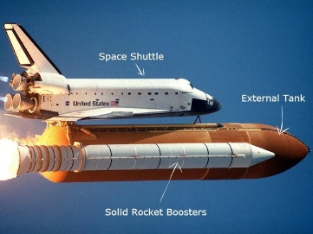
Research the type of fuel that is used to launch rockets today, in 2019, and discuss why the type of fuel might have changed. [3 marks]
Any one of the following fuels (1):
graphene foam
AF-M315E, an energetic ionic liquid (EIL) made of hydroxyl ammonium nitrate fuel/oxidizer (used June 2019)
ALICE – nano-aluminum and ice (2009)
Future – metallic hydrogen
Two reasons why fuel type has changed (2):
Reduction of pollution
More efficient weight-for-weight
New fuels can be made by recombining waste products/using substances from Mars
More stable/safer
Less likely to leak out of tank due to small atomic size
Lower toxicity
Low vaporization

Slide 13
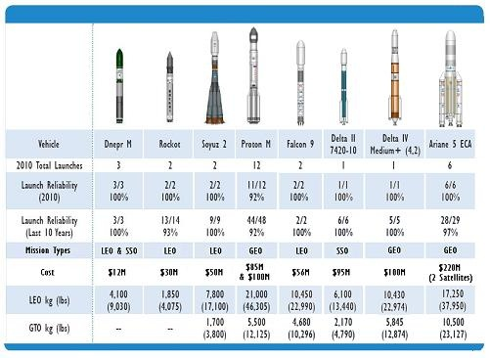
State how much the average rocket would cost to build in 2019 [3 marks]
Wide range of costs depending on payloads and size (1)
Two examples (2 marks)
SpaceX website advertises mission prices of $62 million for a Falcon 9 and $90 million for a Falcon Heavy.
NASA SLS ~$500 million

Slide 14
It is important to form your own opinions that are based on evidence. Discuss whether you believe it is worthwhile spending billions of dollars on space exploration. Include in your discussion two pieces of scientific, economic or ethical evidence. [4 marks]
4 - Presents clear and logical arguments that are supported by evidence. Interprets, compares and evaluates scientific information to support various points of view.
3 - Presents arguments or statements that are not well-supported by evidence. Interprets and compares scientific information to support a point of view
2 - Presents statements of ideas with some development of an argument. Selects some scientific information to support a point of view, but includes some irrelevant or incorrect information
1 - Presents statements of ideas with limited development of an argument. Selects inappropriate scientific information to support a point of view

